Slide 1

Code Refactoring and Bug Fixing
Vazeer Vinay Kumar

Slide 2

Objective of the Project
Key Goal
The objective of the Note Taking Application project is to create a web application using Flask and HTML, allowing users to submit and view notes.
The key goals include fixing bugs, refactoring the code for improved structure, and providing clear documentation of bug fixes. The project emphasizes collaboration, effective bug fixing, and code refactoring practices.

Slide 3
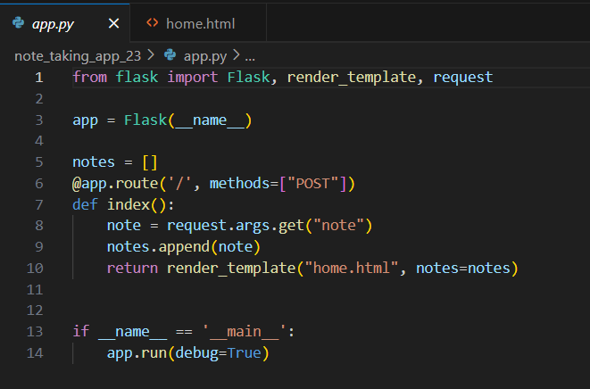
Issues in app.py:
Method Mismatch:
Route set to handle only POST requests (methods=["POST"]).
HTML form missing method="POST" attribute.
Causes method mismatch during form submission.
Note Retrieval:
Using request.args.get("note") instead of request.form.get("note").
Results in incorrect retrieval of form data.
Addressing these issues will align form submission methods and correctly retrieve note data in the Flask application.

Slide 4
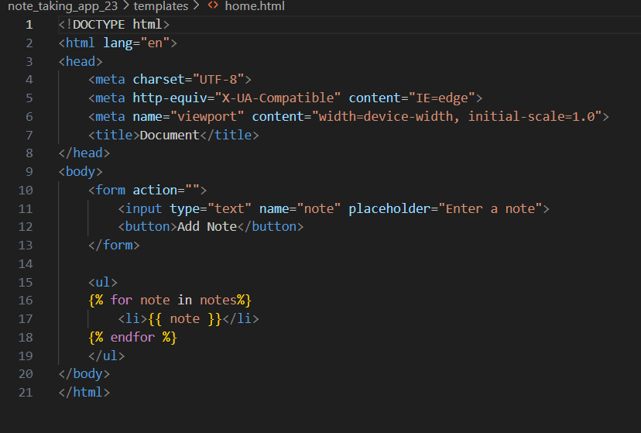
Issues in home.html:
Form Action Missing:
The HTML form's action attribute is empty.
Results in the form not submitting data to the correct route.
Method Not Specified:
Form missing method="POST" attribute.
Defaults to a GET request, causing a method mismatch with the Flask route.
No Note Validation:
No validation to prevent submission of empty notes.
May lead to the display of empty list items.
Fixing these issues will ensure proper form submission and alignment with the Flask route in the Note Taking Application.

Slide 5
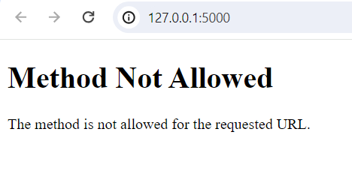
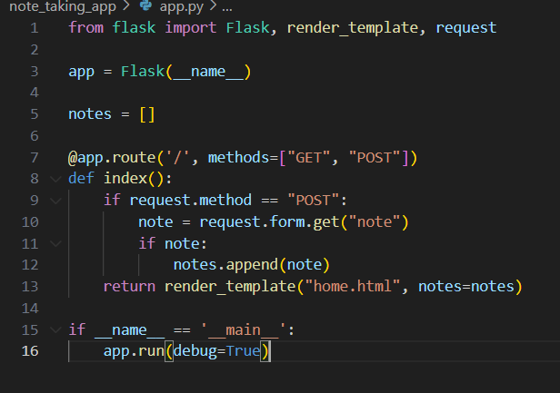
Output of original code:
Since the form is missing the method="POST" attribute, it defaults to a GET request.
The Flask route, however, is set to handle only POST requests (methods=["POST"]).
Changes made:
Updated the Flask route to handle both GET and POST requests (methods=["GET", "POST"]).
Used request.form.get("note") to correctly retrieve the note from the form.
Added a check to ensure that the submitted note is not empty before appending it to the list.

Slide 6
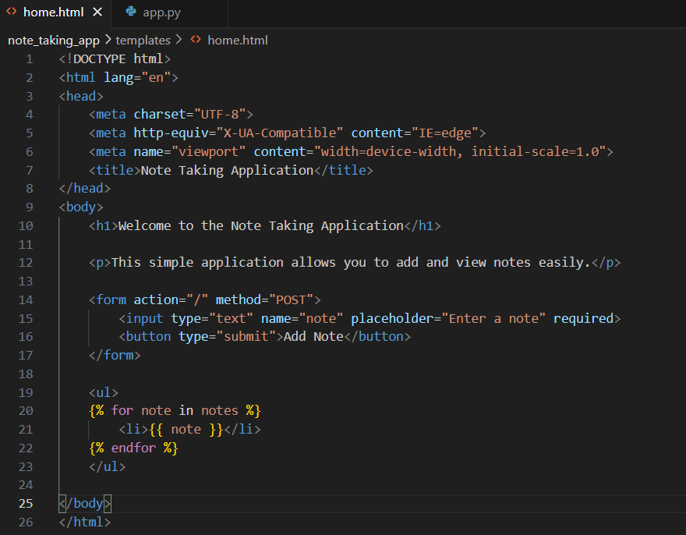
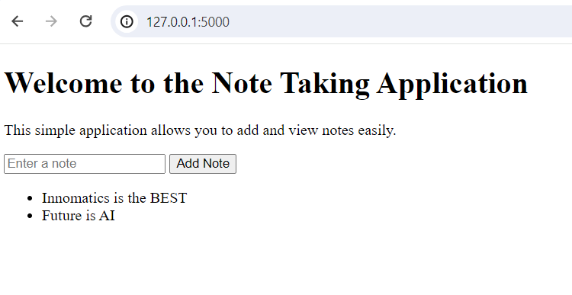
Changes made:
Updated the action attribute in the form tag to point to the correct route using url_for('index').
Added method="POST" to the form tag to ensure proper handling of form submissions.
Added the required attribute to the input field to enforce note entry.
These corrections should resolve the identified issues in the Note Taking Application.
Conclusion for Output of Modified code:
Flask framework utilized for backend functionality.
Implemented both GET and POST methods for route handling.

Slide 7

THANK YOU

